Slide 2
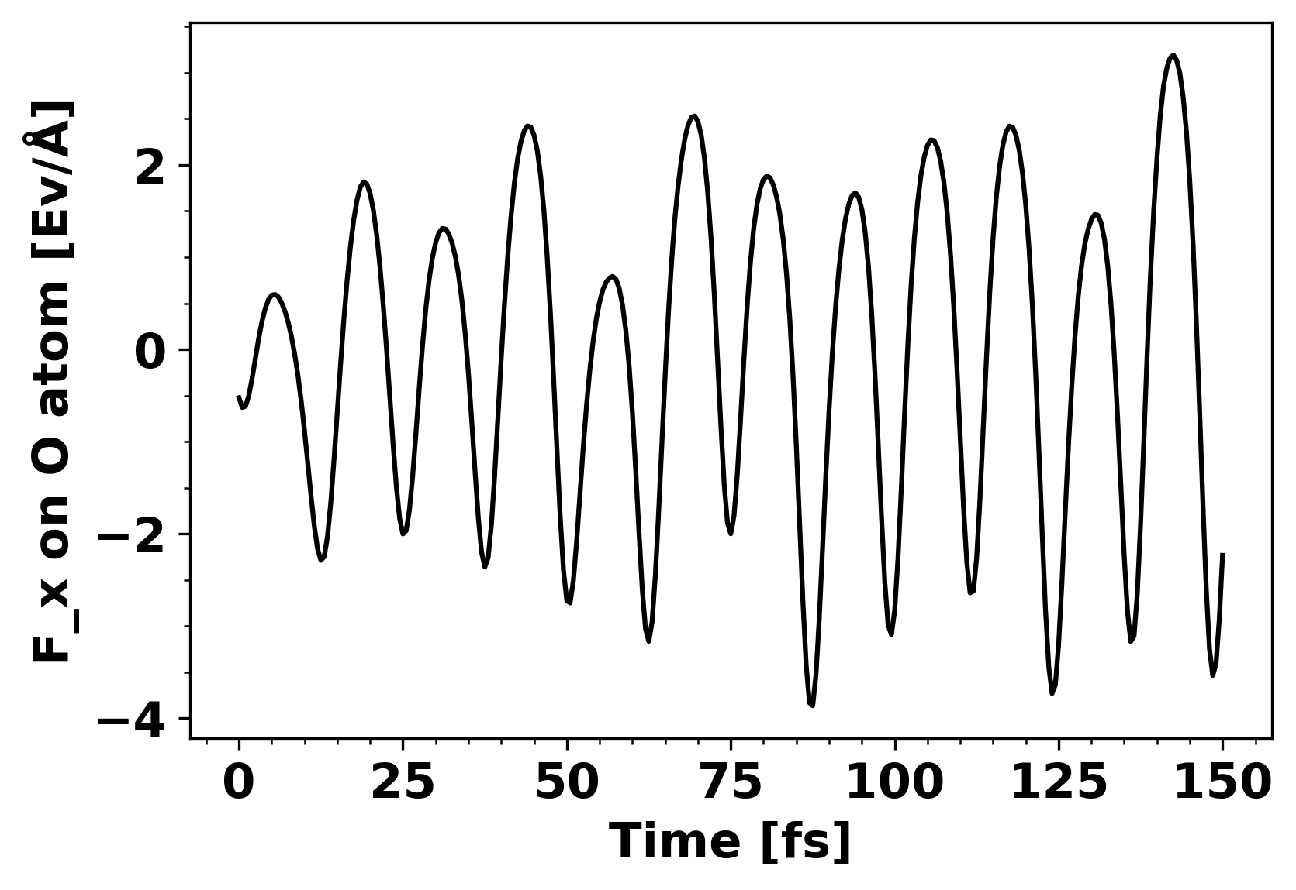
Force Trajectory of Oxygen in Ethanol

Slide 3
Introduction to ARIMA(p, d, q)
AR(p)
MA(p)
I(d)

Slide 4
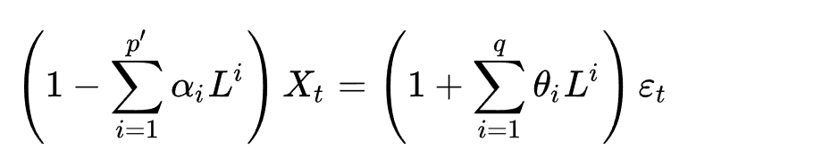
Introduction to ARIMA(p, d, q)
AR(p)
MA(q)
I(d)

Slide 5
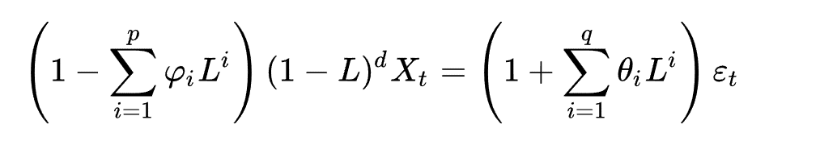
Introduction to ARIMA(p, d, q)
AR(p)
MA(p)
I(d)

Slide 6
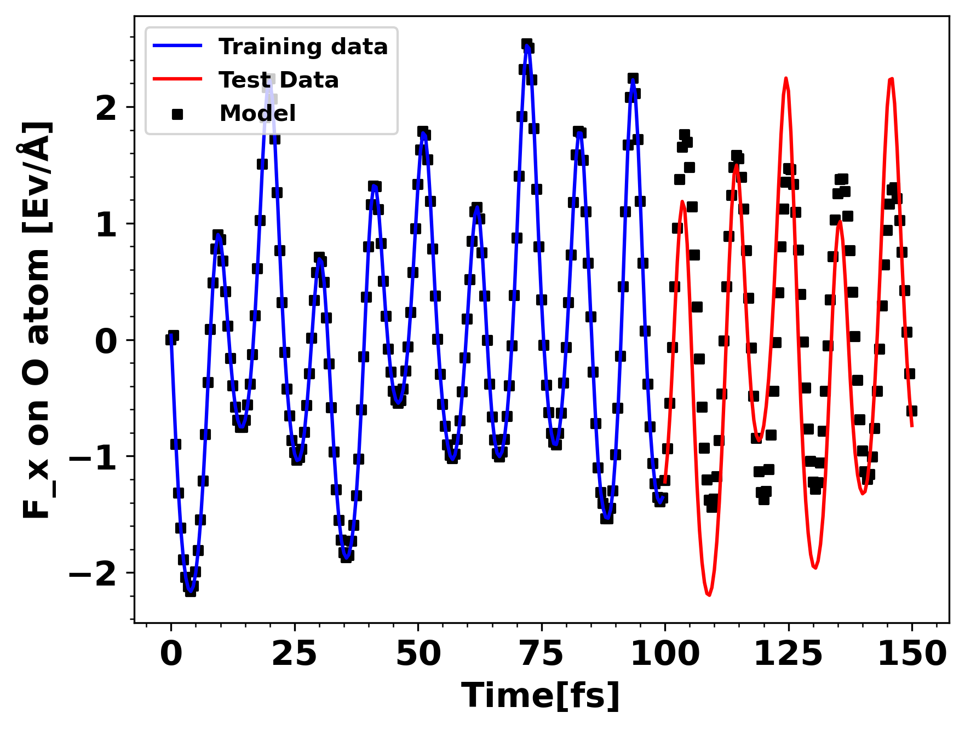
ARIMA(6, 1, 4) Trained on 200 timesteps

Slide 7
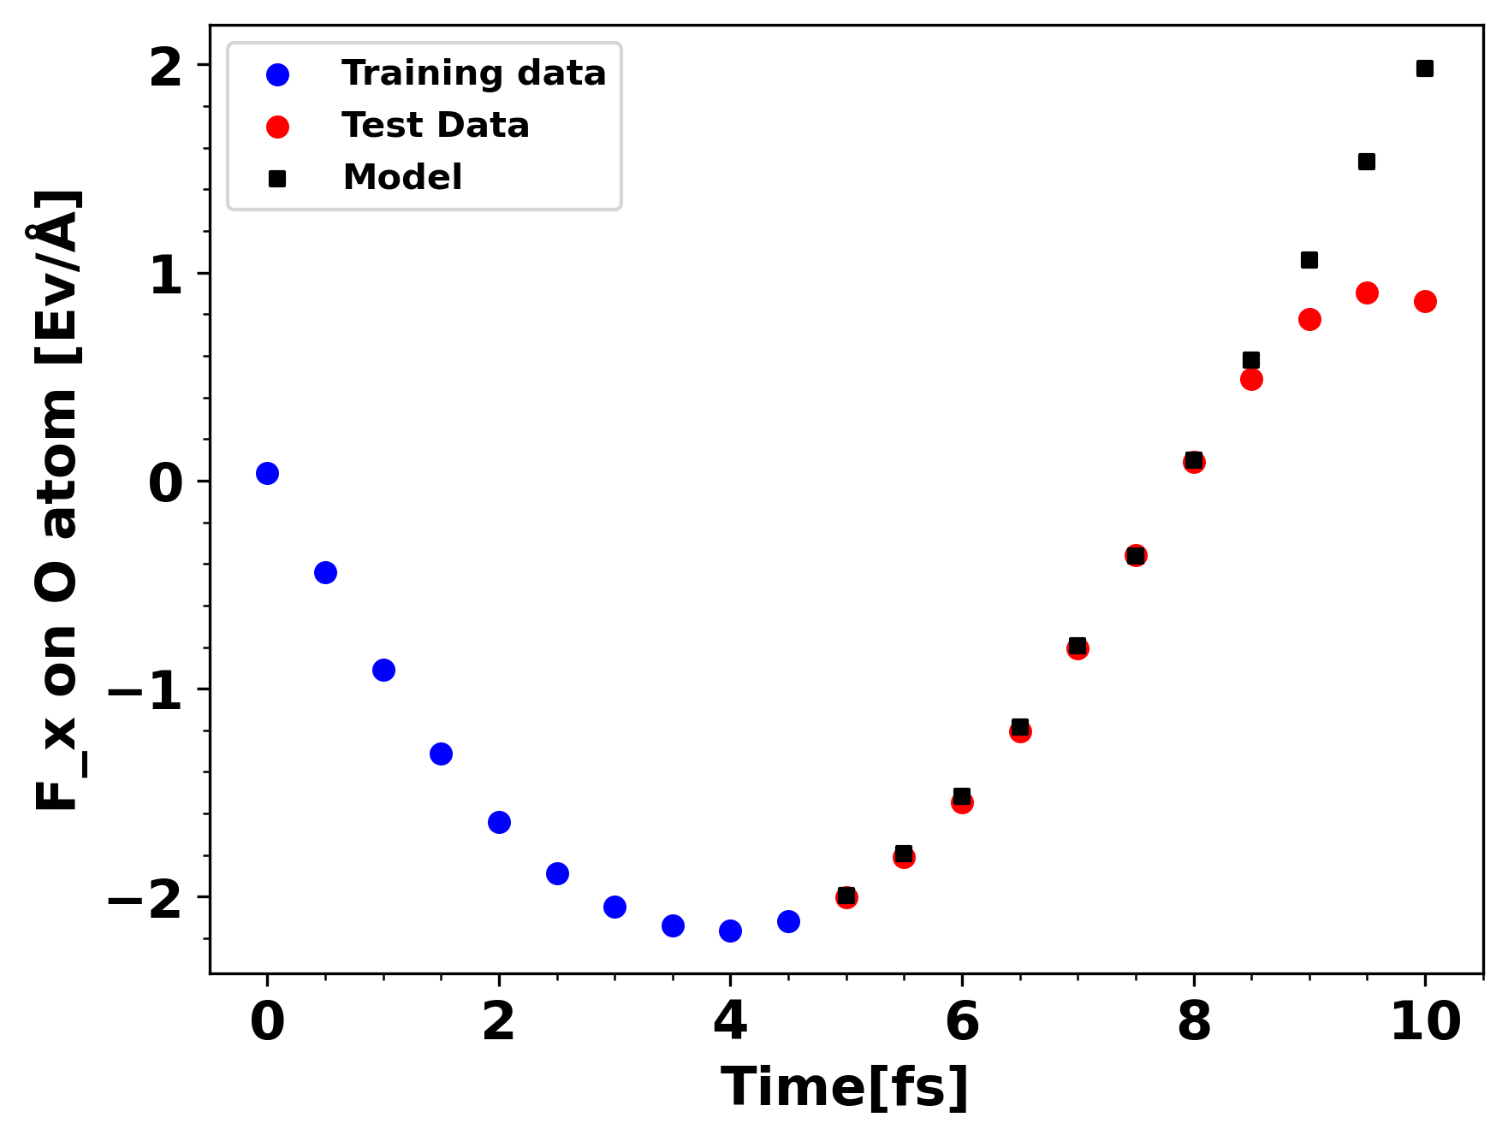
ARIMA(2, 0, 0) Trained on 10 timesteps

Slide 8
Future Tasks
Multivariate forecasting for all forces
Calculate new positions of atoms
Integrate with gpaw

Slide 9
